Slide 1
IEEE QP Winter 2019:
Pill Sorter
A product by Team 11
Using Machine Learning and Arduino to make your health life safer!

Slide 2
Introduction
Taking the wrong pill can be a health risk
Notes:
As we all know medicine can be dangerous. Overdosage, mixing prescriptions, and accidentally taking the wrong pills can be disastrous

Slide 3
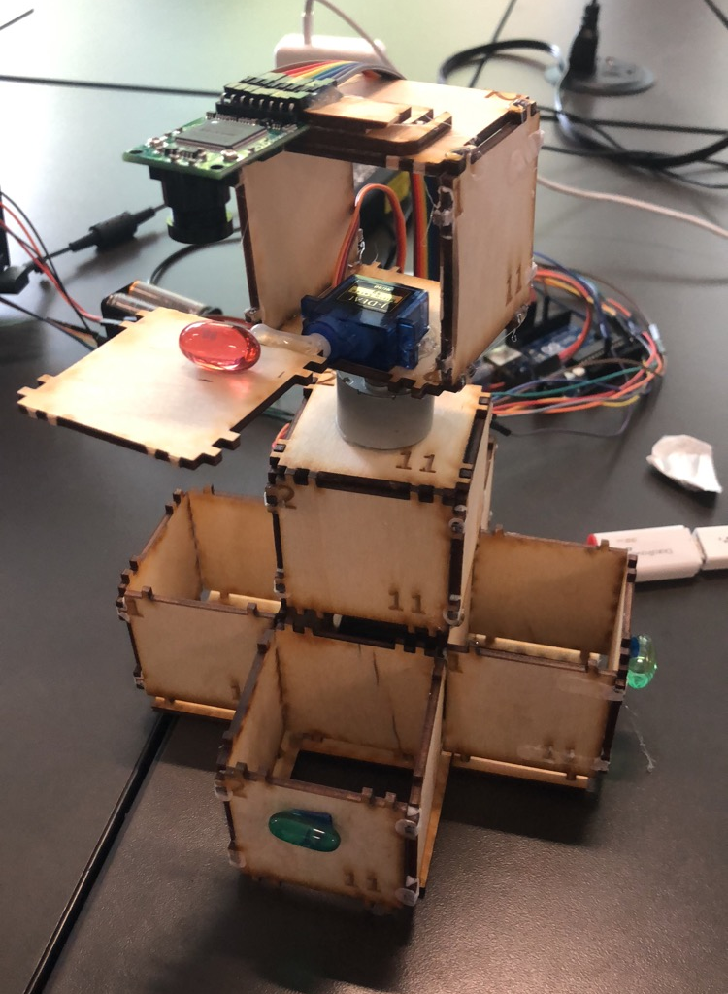
Introduction
Taking the wrong pill can be a health risk
—> Pill Sorter: automatically sort the pill for the patient
machine learning
Arduino
Notes:
Insert the pill sorter, which can automatically sort pills for patients by implementing basic hardware such as an arduino and aspects from machine learning.

Slide 4
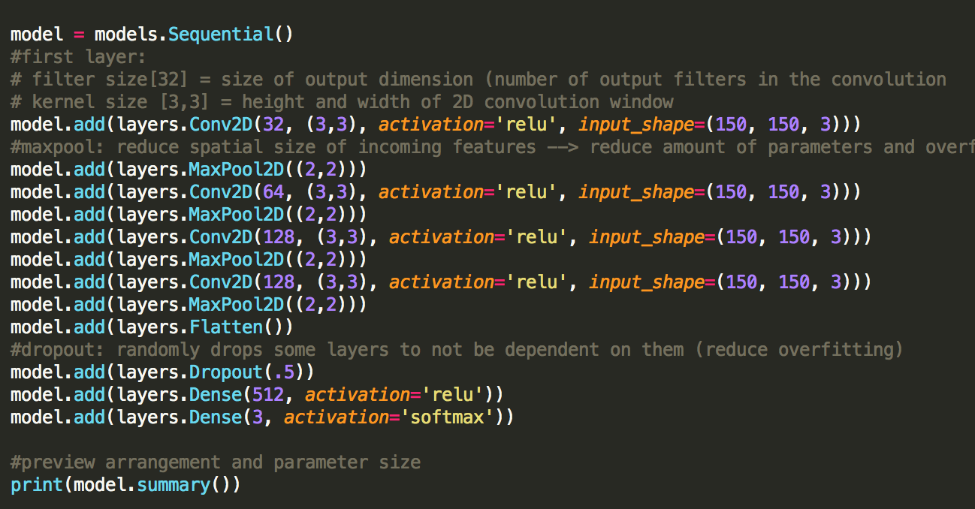
Coding Process
Write Neural Network
Used E4E Mangrove (Dillon’s) as foundation

Slide 5
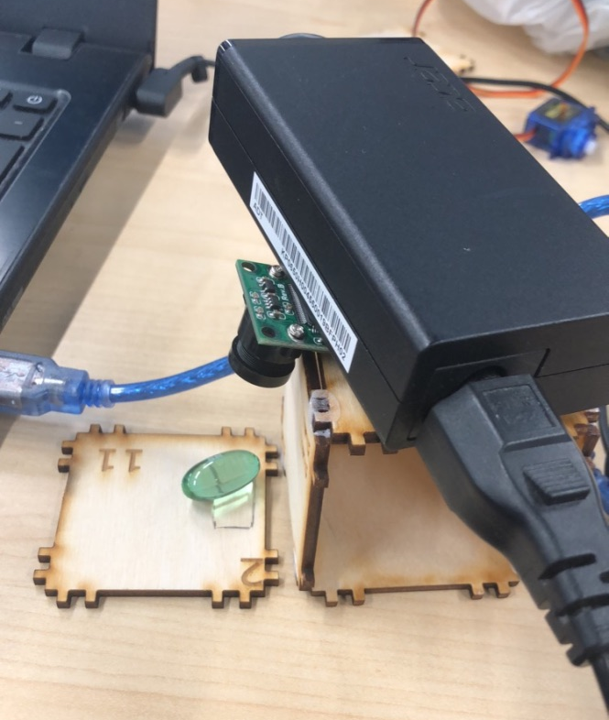
Coding Process
Write Neural Network
Used E4E Mangrove (Dillon’s) as foundation
Create database
Taking a lot of pictures…
Very tedious

Slide 6
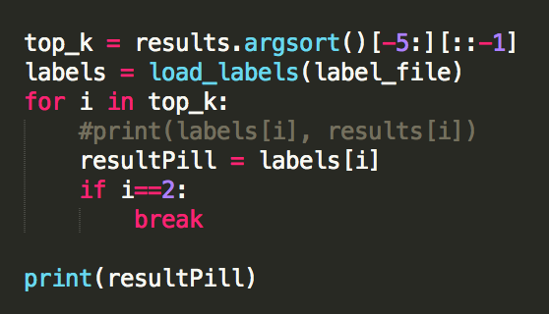
Coding Process
Write Neural Network
Used E4E Mangrove (Dillon’s) as foundation
Create database
Taking a lot of pictures…
Very tedious
Run and save the network, then use it to classify pills

Slide 7
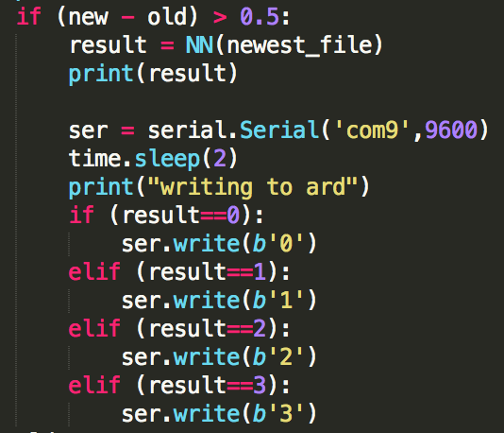
Coding Process
Write Neural Network
Used E4E Mangrove (Dillon’s) as foundation
Create database
Taking a lot of pictures…
Very studious
Run and save the network, then use it to classify pills
Connect to Arduino
Whenever a new picture comes, run the network, classify, and output a value!
That value will correspond to Seth’s code

Slide 8
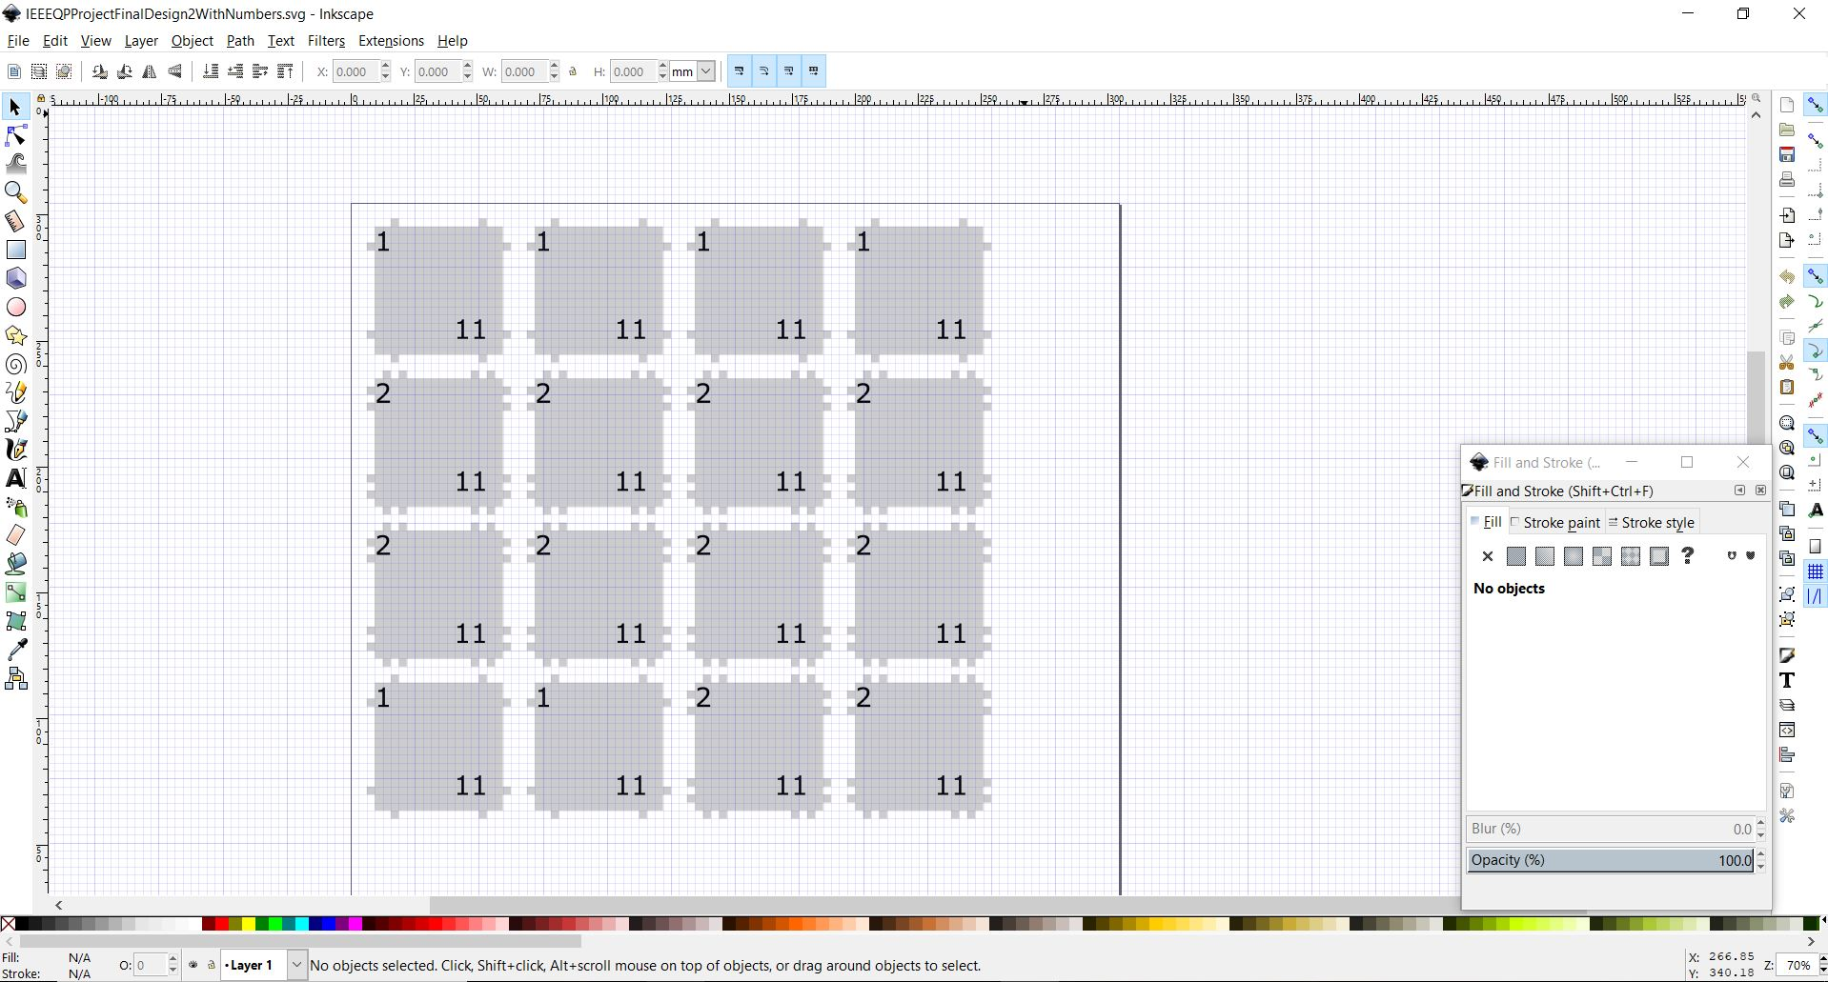
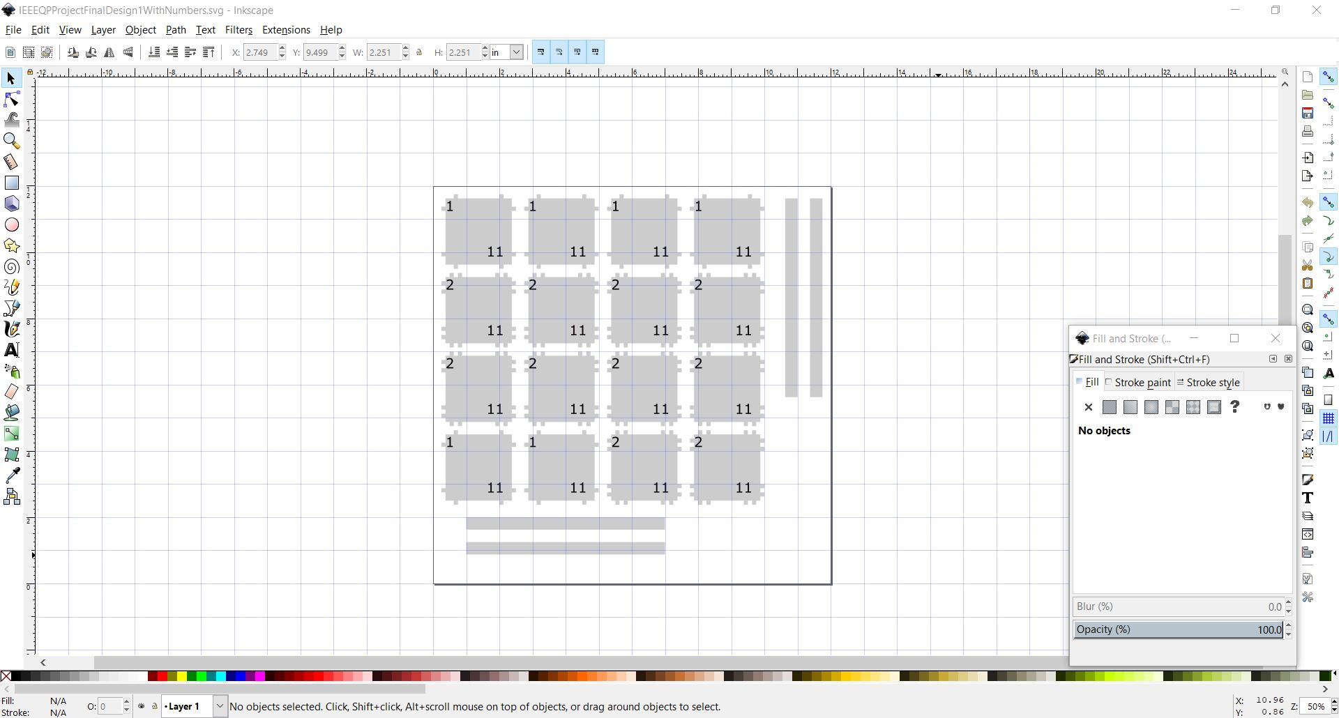
Physical Process
Design parts in Inkscape
Laser Cut the parts
Notes:
The structural process consisted mainly of designing parts in Inkscape and then laser cutting them and assembly.

Slide 9
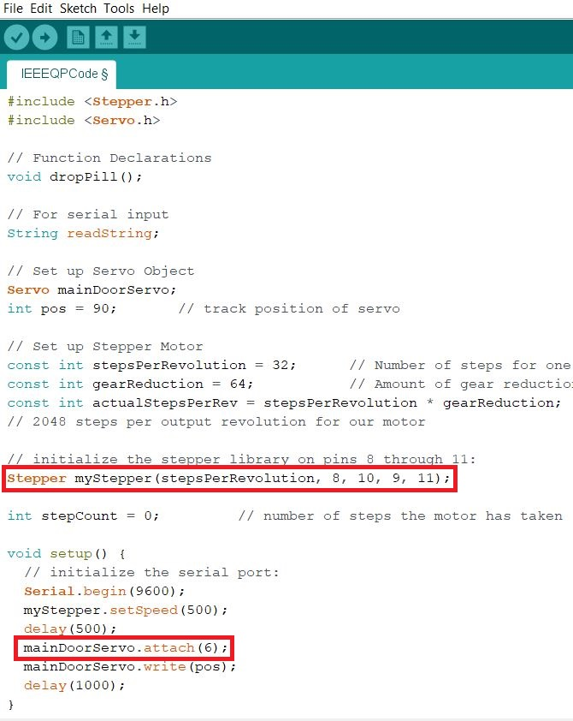
Physical Process
Wire the Servo motor and stepper motor to one arduino.
Stepper Pins 8,9,10,11
Servo Pin 6
Write the code to operate the motors such that the correct pill will be placed in the correct box. (Have the stepper move to the appropriate position and use the servo to drop the pill into the box then return to start position.
Notes:
In addition, we had to wire the servo and stepper motors to the correct pins and voltage so that they could operate adequately.

Slide 10
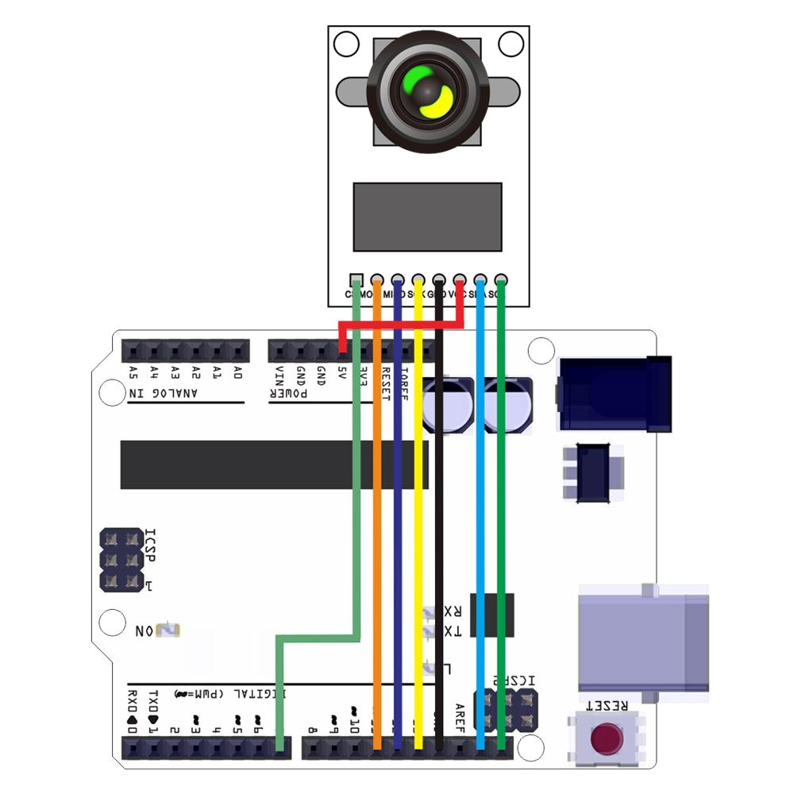
Physical Process
Wire the camera module according to the documentation.
Use the Arducam examples to get the camera functioning and take pictures.
Notes:
The camera module was next and we followed numerous online tutorials and examples in order to get it working. This is a pinout from the designer of our camera module which we used to connect the camera.

Slide 11
Contribution
Ido Durst, Cognitive Science — Machine Learning :
Neural Network
Python coding
Communication with Arduino
Seth Farrell, Electrical Engineering — Machine Learning:
Structural Design
Laser Cutting
Arduino Code
Electrical/Motor Work

Slide 12
Contribution
Struggles
Ido Durst, Cognitive Science — Machine Learning :
Neural Network
Python coding
Communication with Arduino
Seth Farrell, Electrical Engineering — Machine Learning:
Structural Design
Laser Cutting
Arduino Code
Electrical/Motor Work
Arduino camera & Serial communication
Mechanical engineering
Neural network

Slide 13
LIVE DEMONSTRATION

Slide 14
Thank you!
Questions?

